Slide 1

WisH Where is Home
Projeto em Informática
Milestone 3: Construction Phase
Group 7

Slide 2
TABLE OF CONTENTS
01
02
03
INTRODUCTION
CONCEPTUAL MODELING
FRONTEND
04
05
06
BACKEND
DEMO
CALENDAR
The team and context of the project
System requirements and architecture
Website pages explanation
Database and backend explanation
Video demonstration
Dates and future work

Slide 3

THE TEAM
Cristiano Nicolau
DBAdmin
Gonçalo Lopes
DevOps
Joana Gomes
Product Owner
Miguel Miragaia
Team Leader
Tiago Cruz
SCRUM master
Vasco Faria
Architect
Professor José Moreira
Advisor

Slide 4
CONTEXT AND STATE OF THE ART
WisH Where is Home

Slide 5
CONTEXT: PROBLEM & MOTIVATION
The real estate market is saturated with systems that focus on the physical attributes of properties.
An individual's quality of life is closely tied to the availability of services and facilities within or nearby an area.
We wish to enhance the overall well-being and satisfaction of individuals by providing them with a tool which allows them to find a home that aligns with their lifestyle and preferences.

Slide 6
 | Idealista | Imovirtual | ERA | Zillow | Realtor | WisH
Physical aspects of the property
Choose district/ municipality from the map
View
Establishments nearby
Parking spaces
GreatSchool Ranking
Air quality, fire risk factor, floods
TransitScore, BikeScore or WalkScore
Portuguese

Slide 7
GOALS
Develop an innovative real estate platform with unique functionalities
Incorporate additional metrics
Client can explore areas based on personal preferences

Slide 8



EVALUATION METRICS
HEALTH
NATURE & SPORTS
Health services
Hospital
Pharmacy
Clinic
Veterinary
Sports Center
Camping
Parks
Swimming Pool
Beaches & Rivers
Bicycle Path
Walking Routes

Slide 9

EVALUATION METRICS
SOCIAL & LEISURE
SERVICES
Night life
Hotel
Culture
Entertainment
Services
Bank
Post Office
Public Facilities
Car Park
Industrial Zone

Slide 10

EVALUATION METRICS
EDUCATION
COMMERCE
School
Library
Kindergarten
University
Supermarket
Bakery
Food Court
Commerce

Slide 11
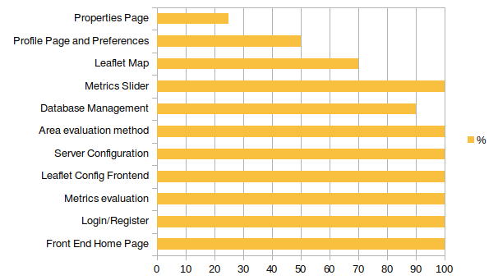
TASKS
Figure 1 - Tasks

Slide 12
CONCEPTUAL MODELING
WisH Where is Home

Slide 13
Functional Requirements
A Client should be able to:
Login/Register
Manage account details
Manage personal preferences
Interact with and filter the evaluation metrics
View results based on the metrics
A Seller should be able to:
Login/Register
List properties for sale
Add property details
Upload photos/videos

Slide 14
Non-functional Requirements
Performance: Response Time & Scalability
Security: Authentication and authorization & Data protection
Usability: Ease of use
Maintainability

Slide 15
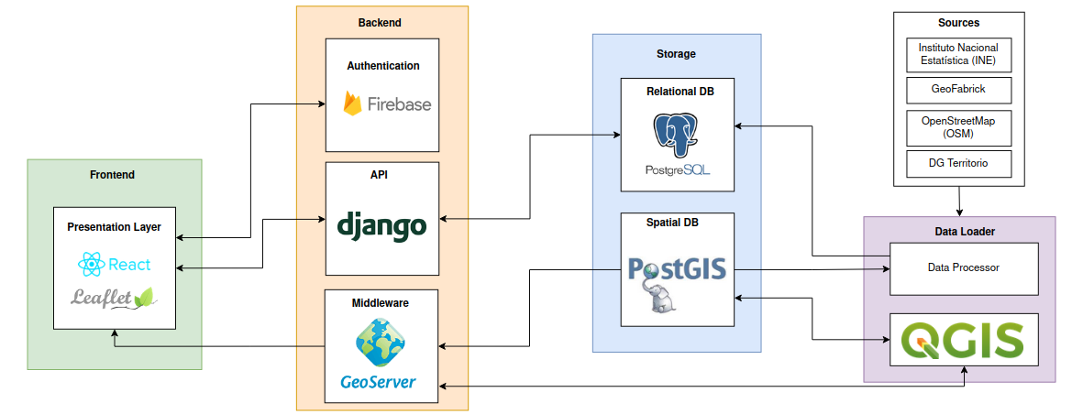
SYSTEM ARCHITECTURE
Figure 2 - Architecture

Slide 16
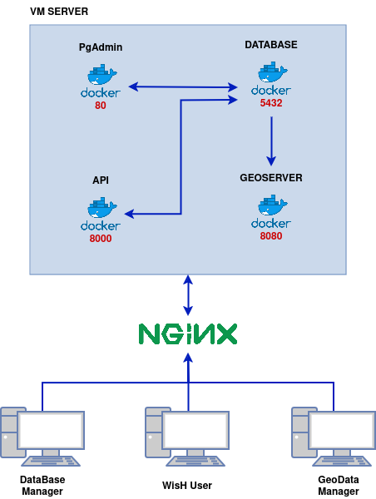
DEPLOYMENT ARCHITECTURE
Figure 3 - Deployment Architecture

Slide 17
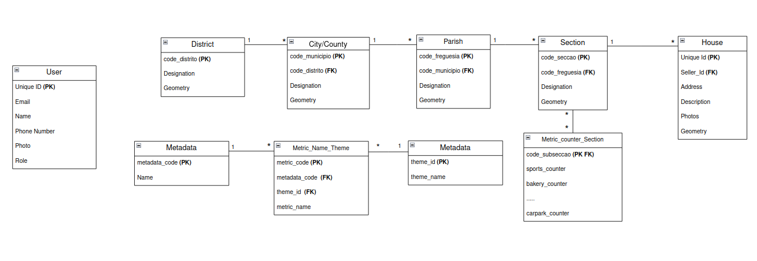
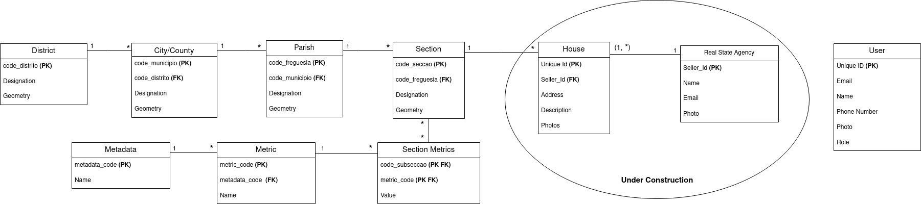
DOMAIN MODEL
DOMAIN MODEL
DOMAIN MODEL
Figure 4 - Domain Model

Slide 18
FRONTEND
WisH Where is Home

Slide 19
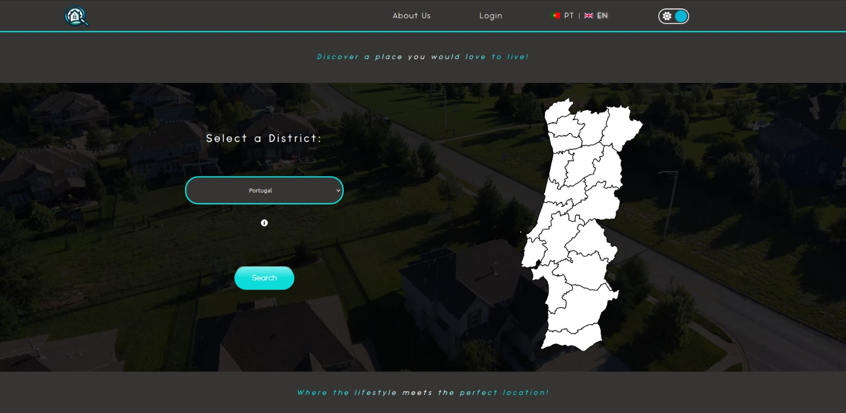

Slide 20
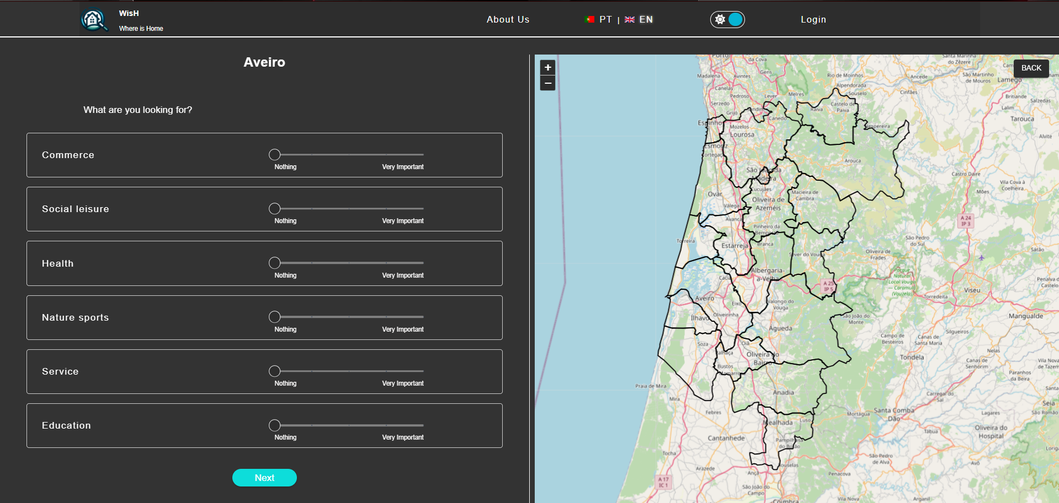

Slide 21
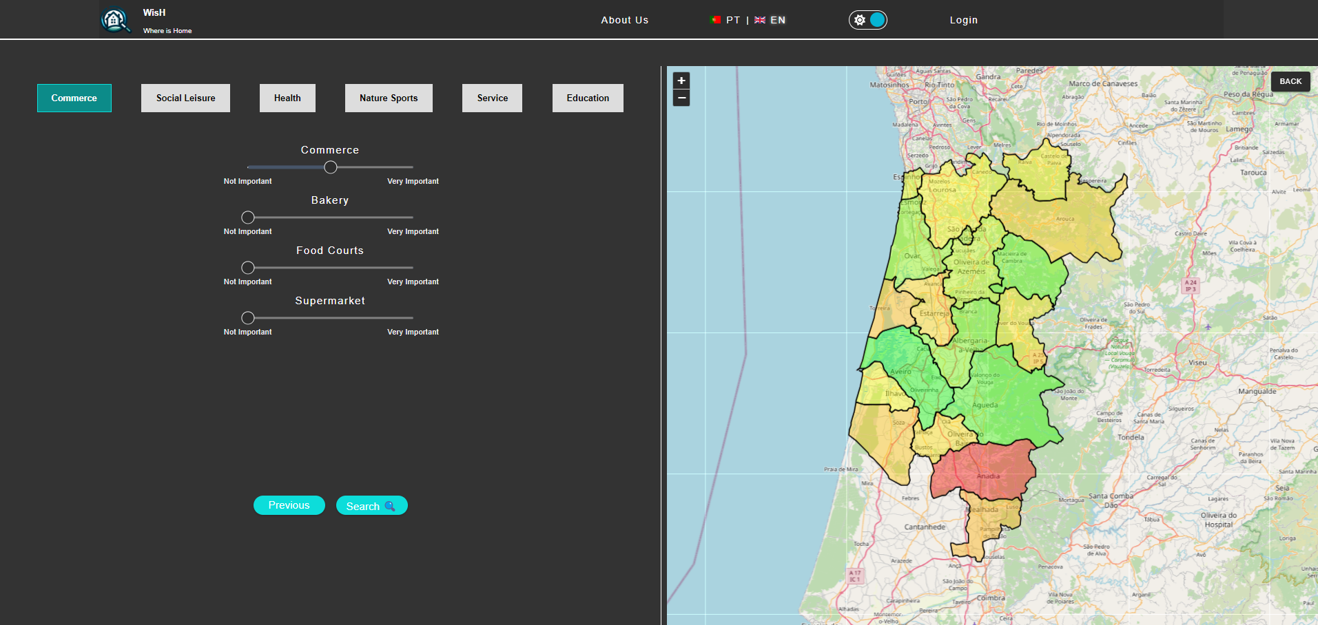

Slide 22
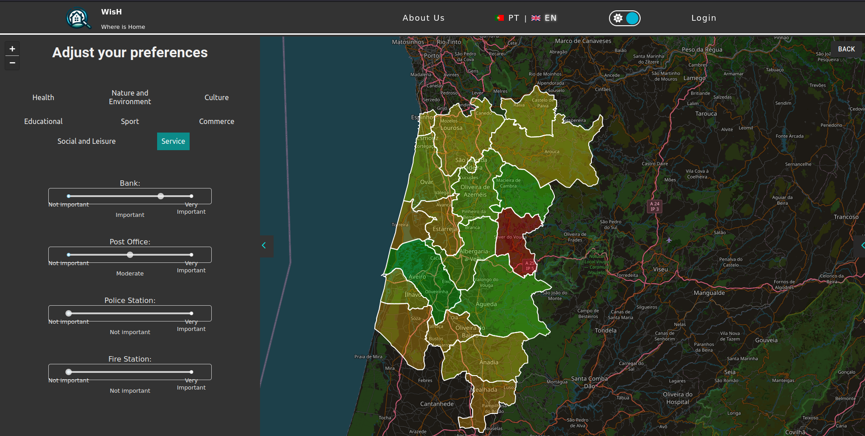

Slide 23
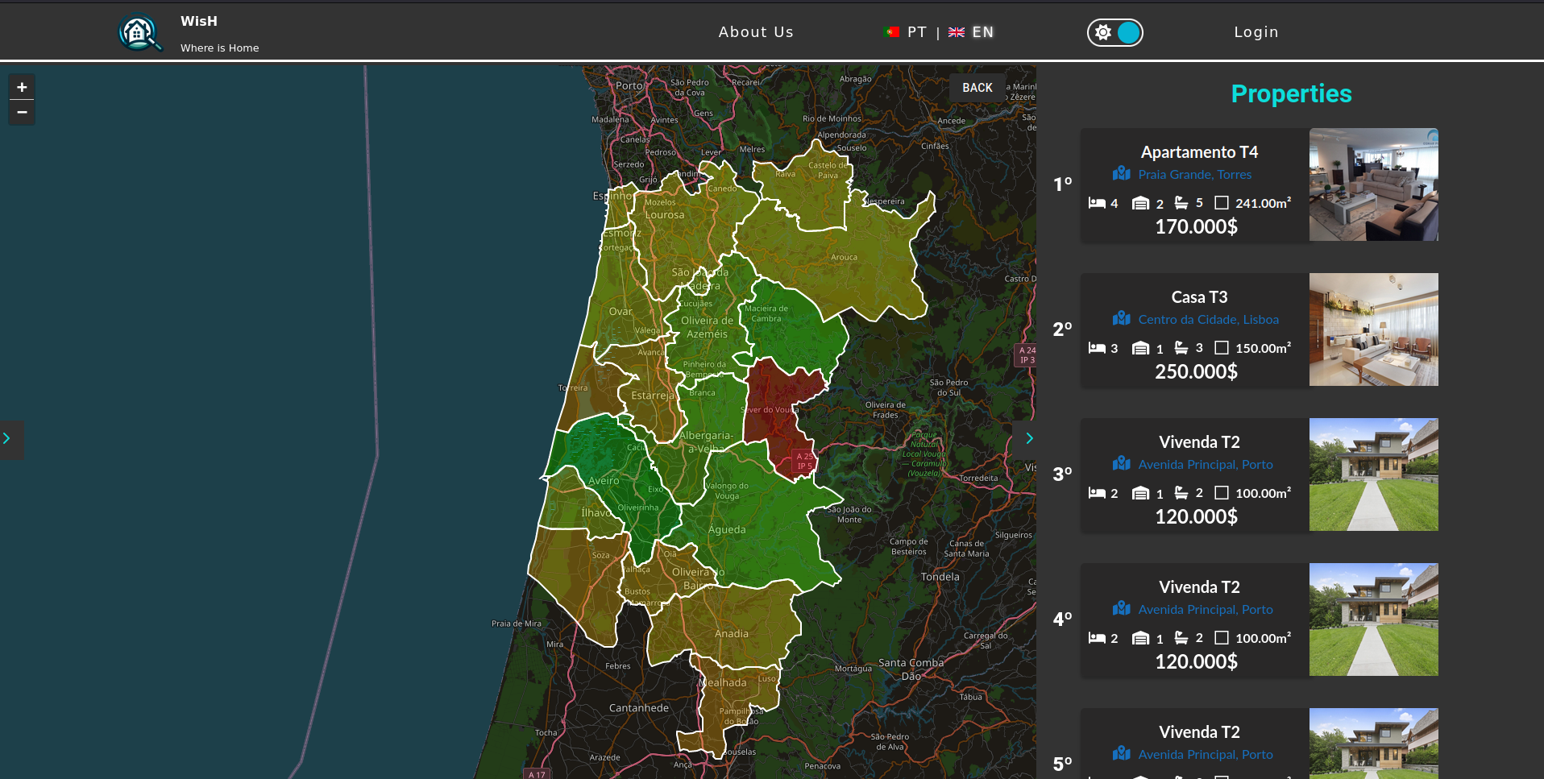

Slide 24
BACKEND
WisH Where is Home

Slide 25
EVALUATION METRICS
District
City/County
Aveiro (01) Aveiro (0101) | Pharmacies | Hospitals
Aradas (010101) | 2/2000 | 0/2000
Glória (010102) | 3/3000 | 1/3000
Vera Cruz (010103) | 5/2500 | 0/2500
Score per Area = Counter / Area
Counter - Number of “Metric” in the region
Area - Area of the region

Slide 26
EVALUATION METRICS
Aveiro (01) | Pharmacies | Hospitals
Aradas (010101) | 0.001 | 0
Glória (010102) | 0.001 | 0.00033
Vera Cruz (010103) | 0.002 | 0
Take the highest value and divide all scores by that value, obtaining a comparison score between each by metric

Slide 27
EVALUATION METRICS
Aveiro (01) | Pharmacies | Hospitals
Aradas (010101) | 0.5 | 0
Glória (010102) | 0.5 | 1
Vera Cruz (010103) | 1 | 0
Result = Score of each Metric by region (ScoreMetByZone)

Slide 28
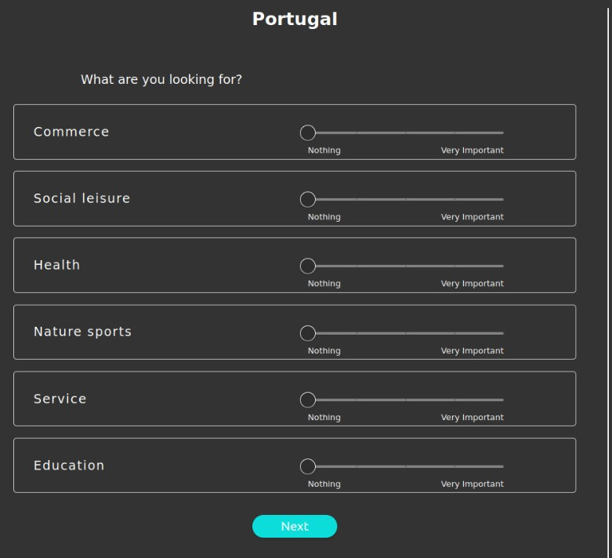
EVALUATION METRICS
Value stored in the Database
ScoreMetByZone
SliderMetScore
Value retrieved from the Sliders of the Theme Evaluation

Slide 29
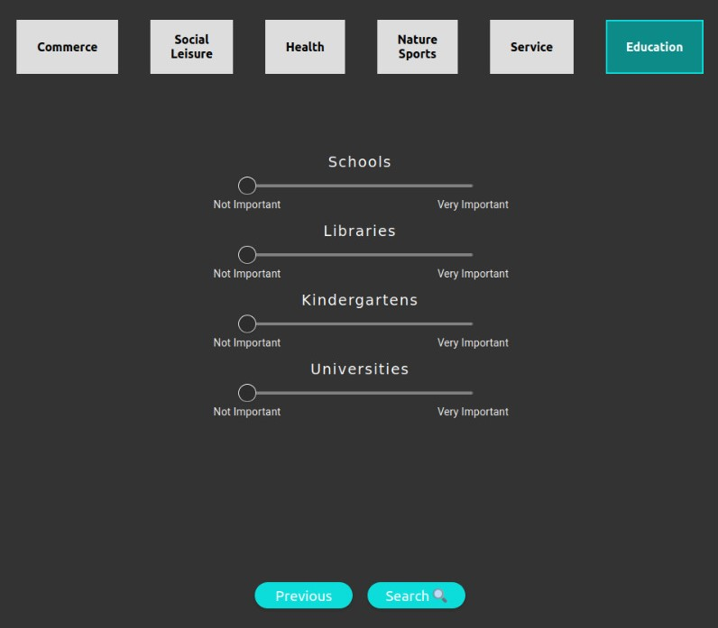
SliderThemeScore
Value retrieved from the Sliders of the Metric Evaluation
ScoreThemeXByZoneX = (ScoreMetByZone x SliderMetScore) x SliderThemeScore
FinalScoreZoneX = ScoreTheme0ByZoneX + ScoreTheme1ByZoneX + ScoreTheme2ByZoneX + ScoreTheme3ByZoneX + …
Sum of all Theme Score for zone X

Slide 30
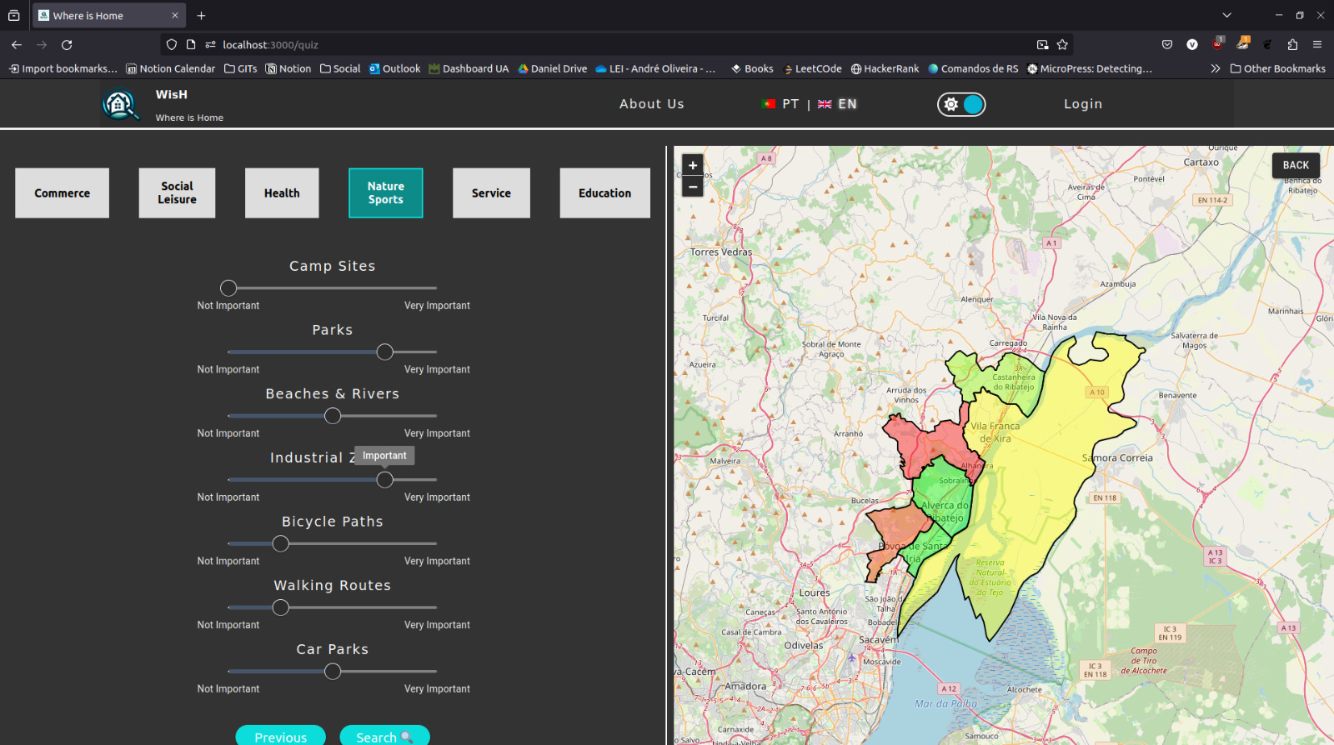
Zone with the lowest score amongst all displayed zones
Zone with the highest score amongst all displayed zones

Slide 31
DEMO
WisH Where is Home

Slide 32


Slide 33
CALENDAR
WisH Where is Home

Slide 34

PROJECT CALENDAR
March
April
Leaflet
Configuration
Frontend
Server Configuration
M2
M3
12/03 - 01/04
15/03 - 20/04
12/03
15/03 - 23/03
06/04 - 11/04
16/04
Database modeling and Backend Development based on the main core user stories
UI Development based on the main core user stories
Calendar

Slide 35
PROJECT CALENDAR
April
May
June
M3
M4
24/04 - 10/05
30/04 - 15/05
15/05 - 25/05
16/04
Developing the remaining user stories and API and backend stabilization
Final development of the UI
Integration and Developing of additional features
04/06
Calendar

Slide 36
FUTURE WORK
WisH Where is Home

Slide 37
Future Work
Insert Student Residences into Third Page
Complete Student driven prototype and Reunion with Professor João Marques
Present the prototype to “Serviços de Ação Social”

Slide 38


THANK YOU
Does anyone have any questions?
https://whereishome.netlify.app/

